Slide 1
CASESTUDY: AIRPORTS ANALYTICS Analysis with MongoDB
19CSE357 | Group 11
BIGDATA ANALYTICS

Slide 2
RAVELLA ABHINAV
CB.EN.U4CSE19453

Slide 3
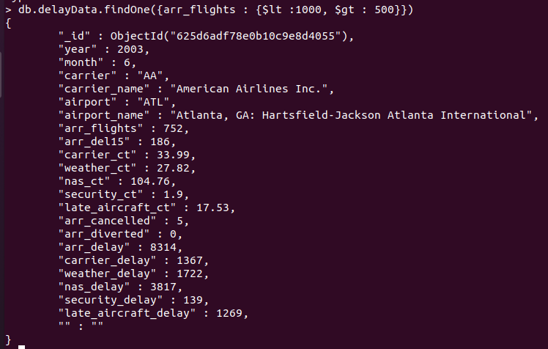
1. Find the airports that which flights count in between 500 and 1000?
Query:
db.delayData.find({arr_flights : {$lt :1000, $gt : 500}})
To find one document:
db.delayData.findOne({arr_flights : {$lt :1000, $gt : 500}})

Slide 4
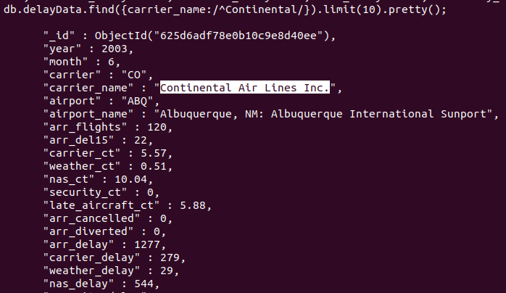
2. Find the airline name that starts with "Continental".
Query:
db.delayData.find({carrier_name:/^Continental/}).limit(10).pretty();

Slide 5
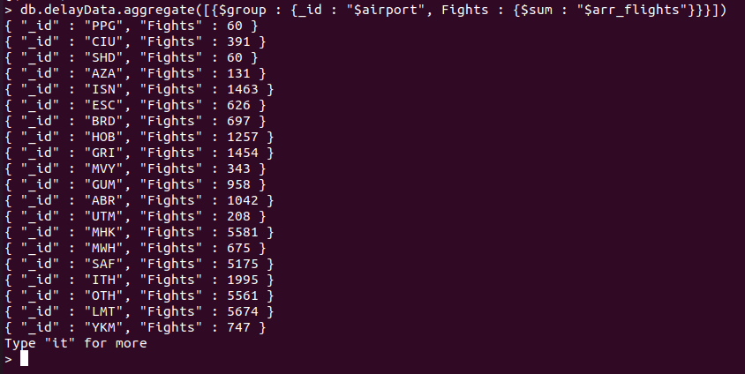
3. Find the count of flights that are arriving for airports.
Query:
db.delayData.aggregate([{$group : {_id : "$airport", Fights : {$sum : "$arr_flights"}}},{"$sort": {Flights: 1}}])

Slide 6
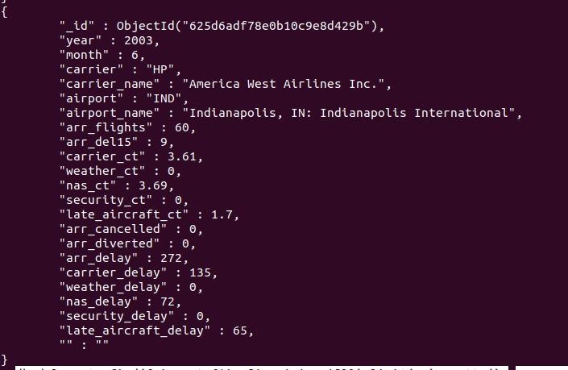
4. Find the carrier names that belongs to ANC and IND airports
Query:
db.delayData.find({airport:{$in:['ANC','IND']}}).limit(10).pretty();

Slide 7
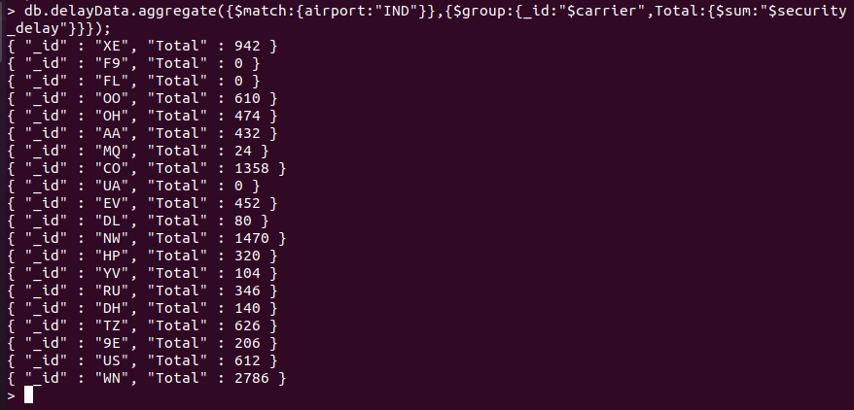
5. Find the total security of IND airport with airlines having security delays
Query:
db.delayData.aggregate({$match:{airport:"IND"}},{$group:{_id:"$carrier",Total:{$sum:"$security_delay"}}});

Slide 8
6. Find the number of flight diversions that occur in St Louis
var m1 = function(){ var rval = { airport: this.airport_name, year: this.year }; if( this.airport=="STL") { emit( rval, this.arr_diverted ); } };
var r1 = function( key, valArr ) { return Array.sum( valArr ); }
db.delayData.mapReduce( m1, r1, {out:'tmp'});
db.tmp.find().sort( {'_id.year':-1} )

Slide 9
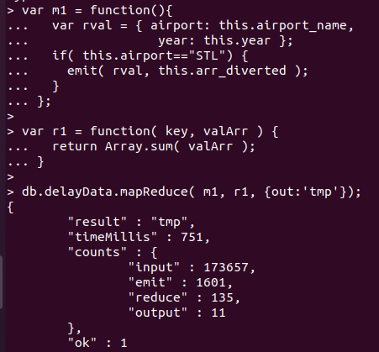
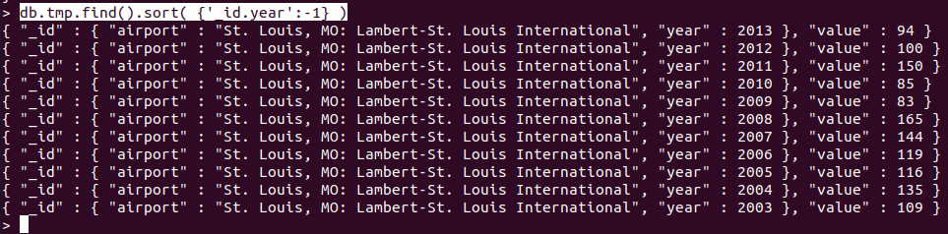
MapReduce Output

